Slide 1
SQL Server 2012 High Availability and Disaster Recovery
Denny Cherry
mrdenny@dcac.co
twitter.com/mrdenny

Slide 2
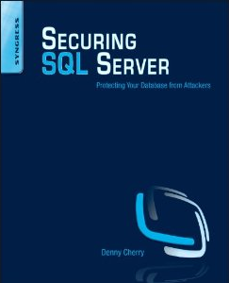
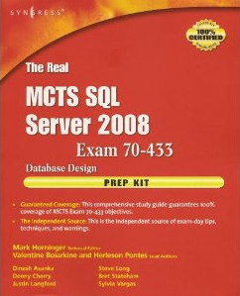

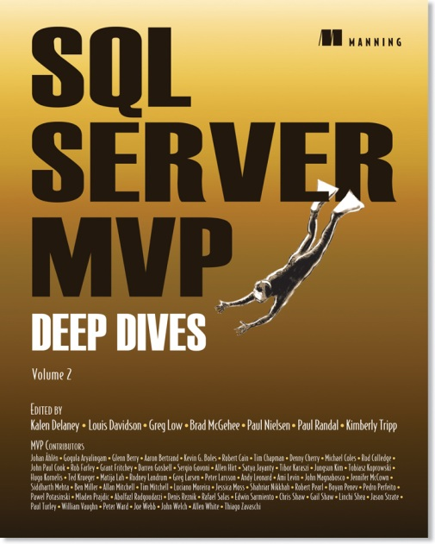




About Me
Denny Cherry & Associates Consulting
Author or Coauthor of 7 books
8+ SQL Mag articles
Dozens of other articles
Microsoft MVP
Microsoft Certified Master
VMware vExpert
Microsoft Certified Trainer

Slide 3
I love questions
Try and keep them on point…
We can always chat during lunch or after the session…
Remember…
There’s no such thing as a dumb question…
But don’t take it personally if we all laugh at with you.

Slide 4
Today’s Topics
Database Log Shipping
Database Mirroring
AlwaysOn
Windows and SQL Server Clustering
Availability Groups
When should I use each one?

Slide 5
SQL Server log shipping

Slide 6
What Is Log Shipping?
Oldest HA/DR solution available
Backup of logs from one server
Restoring of logs to multiple servers
Allows backup servers to be keep X minutes behind
Notes:
SQL Server Transaction Log shipping is the oldest HA solution that we have, and it is the least fun of the available options to work with. One of the big benefits of SQL Server Log shipping is the ability to keep the secondary servers X minutes or hours behind the primary server. This may be done in order to make it easier to restore database from the backup server to the production server in the event of data deletion on the primary server. If this were to happen the data from the secondary server could simply be restored from the backup server by pausing the log shipping, bringing the backup server up in STANDBY mode and exporting the data via BCP, SSIS, etc. to the primary server.
SQL Server Log Shipping can be used in conjunction with all the other high availability techniques which we will be talking about which include Clustering, Mirroring, and AlwaysOn Availability Groups. In some of these configurations, such as with the AlwaysOn Availability Groups the native log shipping won’t recognize the moving of transaction logs from a secondary replica to the log shipping server, however third part scripts can be used instead of the native log shipping configuration system.
Unlike solutions like AlwayOn, SQL Server Log shipping works no matter what your Windows Active directory configuration looks like. You can have multiple Active Directory domains, even different Active Directory forests that don’t have any trusts setup. This is because you can use any method which you like to move the data between the servers. This includes doing a standard Windows file copy, a backup across the network, FTPing the files to the remote SQL Server directly, FTPing the files to an intermediate FTP server on the corporate network or even an FTP server on the public Internet.

Slide 7
Differences Between Native and Roll Your Own
Native
Roll Your Own
Nice UI for setup
Easy configuration of restore delays
Integrated with SSMS
Errors can be cryptic
UI has a couple of bugs
Total control of the process
Very easy to add or remove destination servers
All T-SQL or PoSH Based

Slide 8
Demo!
Notes:
Demo how to setup native log shipping

Slide 9
Rolling Your Own…
Can be done through all T-SQL or not
Can use one file, or one file per T-Log backup
Can be setup to keep one of more targets behind production

Slide 10
Demo!
Notes:
Demo how to setup a roll your own solution using “2 - Roll Your Own Log Shipping”

Slide 11
Failing Over Log Shipping
Configure application to use a DNS alias to connect
Fail the database over (methods here vary)
Change DNS to point to the new server
Force DNS replication
Flush DNS cache on all client machines
Notes:
Failing over a transaction log shipping configuration can be a pretty slow process as there are lots of things that have to be done manually, and in conjunction with your Windows Admin team. The first thing to do is to, when first configuring log shipping, setup a DNS alias (typically a CNAME is used) which points the name that your users will connect to, to the correct server. This way when you want to fail over the database to another server, the DNS record is modified so that it points to the new server. After this, DNS replication may need to be forced as if in a multi-site environment the DNS change may take time to replicate. By default Active Directory (and DNS) replication only replicate every 15 minutes. Depending on WAN bandwidth, utilization, etc. the Windows Admin team may have configured Active Directory replication to replicate less often than this. That being the case, if the DNS change is made at a site other than the one that the users are located in, the users will be trying to connect to a server which is down, or no longer exists.

Slide 12
Native Failover Process
Just use the UI to failover

Slide 13
Roll Your Own Failover Process
Backup final log on source with NORECOVERY
Restore final log on target with RECOVERY

Slide 14
Demo!
Notes:
Demo how failover concept works using “3 - Demo Log Shipping Switching.sql”

Slide 15


Automatic Failover
Nope
NO!
Not Going To Happen
Notes:
There is no automatic failover process when using SQL Server Log Shipping. This is because, when using log shipping unless you failover the system manually there is no way to guarantee that there is no data loss. Microsoft’s standing policy when building high availability solutions is to never trigger any sort of automatic failover when there is the possibility of data loss. This is why you don’t see anyone building automatic failover solutions for the SQL Server Log Shipping. If anyone does release an automatic failover solution for SQL Server Log Shipping be very careful when using it as you run a serous risk of data loss in a configuration like this.

Slide 16
Questions?
?

Slide 17
Database mirroring

Slide 18
Why do I care about a deprecated feature?
Database Mirroring has been deprecated as of SQL Server 2012
Feature will be in the product until at least 2016
Feature will be supported by Microsoft until at least 2026
Notes:
We care about Database Mirroring, because even though it has been deprecated database mirroring is going to be around for quite a while in many shops. This is because while Database Mirroring has been deprecated, it’ll be a feature within the product for at least 2 more major releases. Assuming that Microsoft ships a new database engine every 2 years, that means that it’ll be a feature in the product until at least 2016. As the products have an extended support cycle of 10 years, that means that the version of database mirroring which is released in 2016 (assuming they release that year with the second post SQL 2012 release) will still be supported by Microsoft until 2026. In short database mirroring isn’t going anywhere any time soon.

Slide 19
What Does Mirroring Do?
Keeps a second copy of a database updated
Runs synchronously or asynchronously
Synchronous mirroring supported in Standard+
Asynchronous mirroring supported in Enterprise

Slide 20
What Isn’t Mirrored?
Logins
Jobs
SSIS Packages
FILESTREAM
FILETABLE
Basically Anything which is outside of the database doesn’t come across

Slide 21
How does Mirroring Work?
Feeds a transaction log stream from one machine to another
Log is applied and committed as soon as it arrives

Slide 22
Database Mirroring Options
Synchronous
Asynchronous
Two or Three Servers
Supports Automatic Failover
Standard Edition Feature
Witness Can Be Express
Two Servers
Enterprise Edition Feature
Both instances must be EE

Slide 23
Mirroring Communication
Dedicated TCP Endpoint
Default TCP port 5022
Only Mirroring Uses Endpoint
Data Encrypted By Default
Authentication Can Be Windows Auth or Cert

Slide 24
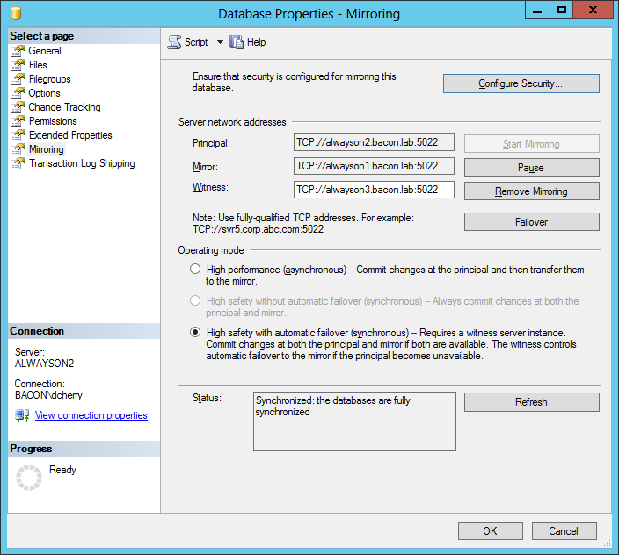
Mirroring Configuration

Slide 25
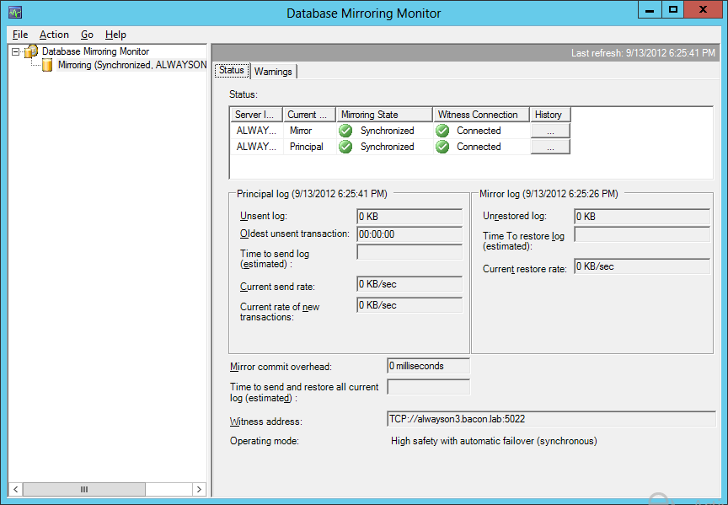
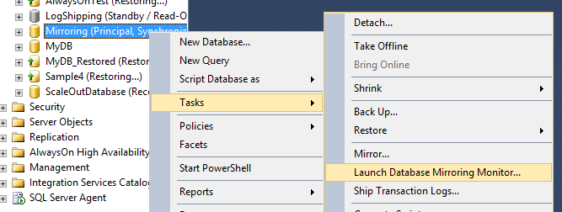
Mirroring Dashboard
Notes:
The database mirroring dashboard can be accessed by right clicking on any database and selecting all tasks, then selecting “Launch Database Mirroring Monitor…”

Slide 26
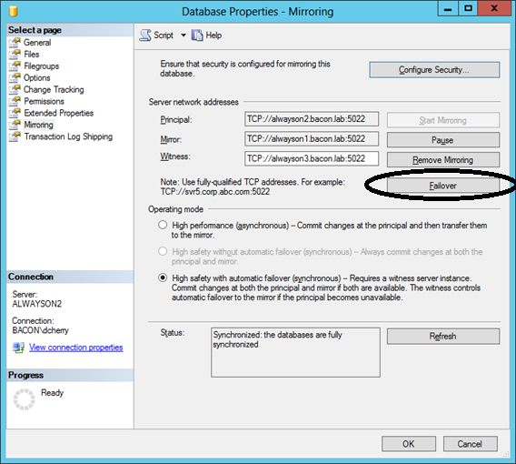

Failing Over Mirroring
Triggered on primary server
T/SQL or SSMS

Slide 27
Demo!
Notes:
Demo setting up database mirroring

Slide 28
Questions?
?

Slide 29
AlwaysOn

Slide 30
What Is AlwaysOn?
Umbrella Term covering multiple features
SQL Server Clustering
Local Clustering
Geographically Dispersed Clusters
Availability Groups
Notes:
The feature called AlwaysOn within SQL Server 2012 includes two features. The first being the legacy feature of SQL Server clustering, the second being the new feature SQL Server Availability Groups feature. While the common use of the feature name of “AlwaysOn” is used to talk about AlwaysOn Availability Groups, this is technically not correct as AlwaysOn describes both of these high availability features

Slide 31
Questions?
?

Slide 32
SQL Server clustering

Slide 33
SQL Server Clustering
Concepts…

Slide 34
SQL Server Cluster Configuration
Built on top of Windows Failover Clustering
Single set of database files
Multiple instances configured to use these database files
Only a Single instance can host the databases at once

Slide 35
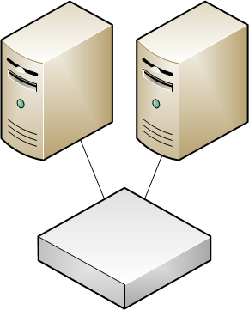
SQL Server Cluster Configuration
Notes:
In the diagram we can see two servers, either physical or virtual. These are both configured to use shared storage. In SQL Server 2012 this shared storage can be SAN attached storage, or it can be a network share on a file server.
If network storage on a file server is going to be used, ensure that file server (or NAS appliance) is running SMB 2.2 (Windows 2008 R2) or higher (preferably SMB 3.0 introduced in Windows 2012) and that the SQL Servers are using an operating system with SMB 2.2 or higher (Windows 2008 R2 or higher). Attempting to host databases on a file server with an OS older than Windows Server 2008 R2, or an appliance which doesn’t support SMB 2.2 or higher, will result in poor IO performance as the older SMB versions are very chatty versions of the SMB protocol.
These windows clusters support up to 16 nodes in Windows Server 2008 and Windows Server 2008 R2 and up to 64 nodes in Windows Server 2012 supporting massive availability solutions to be possible. The reason that we might want very wide Windows and SQL Server clusters is to enable high availability without the need to waste money on lots of redundant servers.

Slide 36
SQL Server Cluster Configuration
Notes:
Given that SQL Server is always in an Active/Passive configuration no matter how many notes there are in the cluster, if we have a bunch of two node clusters we have a 100% cost overhead when we attempt to give 8 instances high availability. This is because each of the pairs of servers above has a passive node sitting there doing nothing 100% of the time increasing our Windows OS license cost and our server cost by 100%.

Slide 37
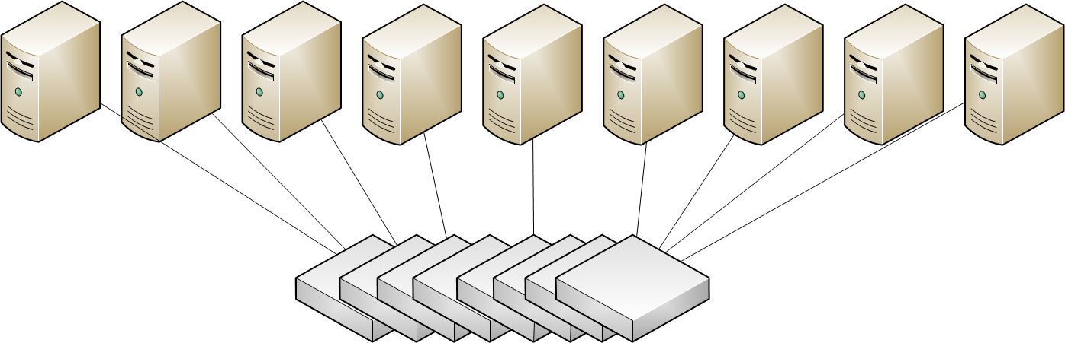
SQL Server Cluster Configuration
Notes:
However in this configuration with the same 8 SQL Server instances, we only have to purchase a single additional server and operating system as all 9 servers are all configured within a single Windows and SQL Server Cluster.

Slide 38
License Limitations
Standard Edition – 2 nodes
BI Edition - 2 nodes
Enterprise Edition – OS Maximum

Slide 39
Instances Redefined
Instances are installed on multiple machines
Multiple instances are configured
Each single clustered instance has the same name
Separate clustered instances have different names
Notes:
You may hear the term FCI being tossed around when talking about SQL Server clustering. FCI simply means Failover Clustered Instance.

Slide 40
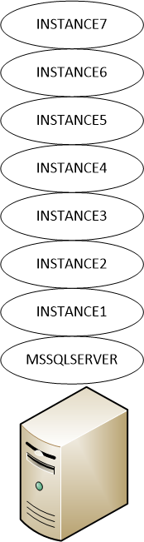
Instances Redefined
Each Instance is installed and managed separately
Each Instance is installed on each of the servers of the cluster (or a subset)
Each instance requires a separate network name and IP address
Notes:
Within the Windows Cluster have the concept of resources and Resource Groups, also called applications and Services. Resources are simply anything which can be clustered such as a network name, IP address, hard drive, SQL Server instance, Windows Service, VB Script, Scheduled Task (Windows Server 2012 and above only), etc. Resources are put into groups so that they can be failed over or moved from one server to another together.

Slide 41



Resource Dependencies
10.2.4.78
Notes:
We define dependencies when configuring our resources within the resource group so that resources come online after moving from one server to another in the correct order. When dealing with SQL Server we want the IP Address and hard drives to some online first. After the IP Address comes online then network name can come online. Once the network name and the hard drives have come online the SQL Server service can come online. Once the SQL Server service has come online the SQL Server Agent can come online. Other resources which are installed on the cluster which should be dependent on the SQL Server service can be made to come online after the SQL Server service has come online, or at any phase in the process depending on what resources the non-SQL Server service needs to come online after.

Slide 42
New SQL 2012 Clustering Features
Multi-Subnet Failover Support
Network Storage Support
Windows Core Mode Installs
TempDB on local disk

Slide 43
Multi-Subnet Failover
Two different IP Addresses configured for SQL
Only one comes online at a time using OR statements within SQL Server
Uses network subnet configuration to determine IP to bring online

Slide 44
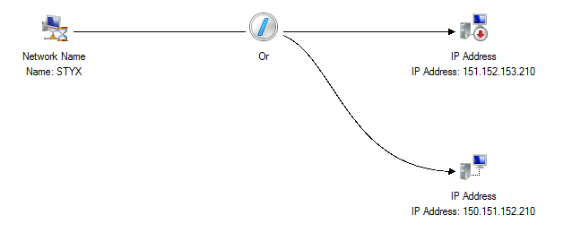
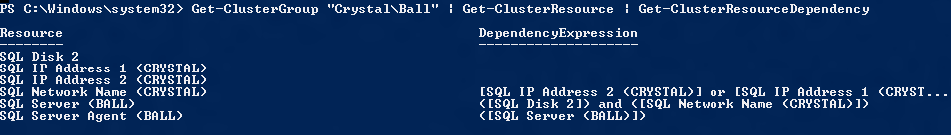
Multi-Subnet Failover
Thanks to Allan Hirt for the images!

Slide 45
Quorum
For the cluster to start and stop services, it must have quorum
Quorum is the requirement to have a vote, without being able to have a tie
Quorum is used to decide which node of the cluster will host the resource groups

Slide 46
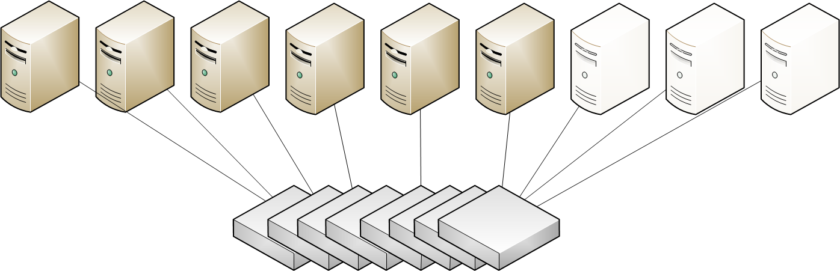
Quorum Options
Majority Node Set
Network Share Quorum
Quorum Drive
Notes:
For smaller installations a quorum drive is the typical configuration. However this does introduce a single point of failure within the cluster as there is only one quorum disk. While the failure of the quorum drive does not cause a quorum failure it does however prevent configuration changes to the cluster until the quorum drive have been repaired. Using a network share as the quorum volume presents the same problems as a quorum disk as it is a single point of failure.
For larger cluster configurations and for all multi-site cluster configurations a majority node set is used, as this requires only that n+1 nodes be online. For a 9 node cluster {click} like this one this requires that at least 8 machines of the cluster be online. This means that any node of the cluster can fail, and quorum is still maintained. With the introduction of Windows Server 2012, this becomes even more redundant as Windows Server 2012 only requires n/2+1 nodes to be online for Quorum to be maintained. With Windows Server 2012, after one of more nodes fail the maximum number of nodes needed to maintain quorum is reduced to the n/2+1 value based on the new total number of nodes.
Given the same cluster above if we were to loose 3 servers {click} do to for example, a power failure within a rack, the Windows Server 2012 cluster would reconfigure itself automatically to account for the fact that the cluster is now made up of only 6 servers, until the 3 remaining servers come back online. After they come online the cluster would automatically readjust the quorum count.

Slide 47
Sql server clustering
Practical Information

Slide 48
Steps to Clustering Windows
Run Validation
Run Clustering Wizard
Notes:
Clustering the Windows operating system is a pretty basic process. There are only a couple of phases to the process. The first is {click} to run the validation wizard. The validation wizard will run through somewhere between several hundred and several thousand tests to ensure that your Windows servers, network, storage, etc. is all configured correctly for Windows clustering. If you are able to pass the validation wizard you have servers which can officially be clustered and will be supported by Microsoft. Without passing the validation wizard SQL Server will not install in a cluster. You have the option of running the validation wizard during the cluster configuration process, however it is recommended to run it before hand so that if there is a problem that can be resolved before entering all the various pieces of information that Windows will be asking you. Depending on how large the Windows cluster is, validation can take anywhere from several minutes to several hours. On a large configuration with a dozen nodes and dozens or hundreds of LUNs being presented start the validation and then go home for the night.
The second step is to run through the wizard which will configure the actual cluster. This wizard will be asking you for a name for the cluster as well as an IP address. If DHCP is used within the data center there is no problem using DHCP for the Windows Cluster. This name will be the name that the cluster is known by, and can’t be changed. Once the basics of the failover cluster are configured via the wizard then more advanced configurations can be made, if needed, and SQL Server can be installed.

Slide 49
Demo!
Notes:
Build a failover cluster

Slide 50
Steps to Clustering Windows
Launch the Clustered Instance wizard
Select the components to install
Configure the network name and IP address which the clustered SQL Server instance will use
Assign disks to the clustered SQL Instance
Define the resource group name
Notes:
The clustered installer for SQL Server is a different installation option within the UI. This is because the SQL Server installation wizard needs to know extra information when doing a clustered SQL Server installation. During the installation process, most of the screens will look very similar such as the {click} SQL Server components screen where you can select the services to install. While all the services are going to be listed here, only the SQL Server, SQL Server Agent and SQL Server Analysis Service services are actually cluster aware. What is meant by cluster aware is that these are the only services which will be configured within resource groups and be configured for failover. The other components will simply be installed on the server in the same way that they would be normally.
As you go through the installation process SQL Server will {click} prompt you for the network name and IP address that the SQL Server will be listening on. Each SQL Server instance requires a separate network name and IP address for the clustered instance to listen on. This is because each of the instances will be hosted in separate resource groups so that they can all be failed over independently from each other.
During the installation you will be prompted to selected the shared disks that the SQL Server will use. Select the disks that you want to use to host the databases for the clustered installation.
About the last screen which will be different will be the screen in the wizard {click} on which you name the resource group which will be used within the failover cluster administrator management tool. While it isn’t needed that the resource group and the network name of the cluster match, it is recommended so that it is easier to find the correct resource group within the failover cluster administrator cluster.

Slide 51
Multi-Node Installation
Each instance is installed on each node separately
Secondary node installations are much simpler
Notes:
When installing SQL Server 2000 and SQL Server 2005 on a Windows Cluster all the nodes were installed at once to minimize the amount of time that it took to install and configure the SQL Server cluster. However this required a much weaker than desired security configuration within the Windows operating system, so this installation method was removed, and you now need to install the instances on each node separately. For large multi-node installations use of the configuration file which the SQL Server installer creates would be highly recommended. Run through the installer for the first passive node once manually, then grab the configuration file, and simply use that to automate the installation of all the other nodes.

Slide 52
Demo!
Notes:
Install SQL Server on the failover cluster

Slide 53
Failover Detection
Cluster Service Logs into SQL Server regularly
Cluster Service runs a basic query
Number of failed attempts acceptable can be configured
Number of times instance can failover within X number of minutes can be configured
Failback is optional (and usually not recommended)

Slide 54
Demo!
Notes:
Show failover settings, failback settings, etc.

Slide 55
Questions?
?

Slide 56
Always On Availability Groups

Slide 57
New Terms to Know
Availability Groups
Availability Replicas
Availability Databases
Availability Group Listener

Slide 58
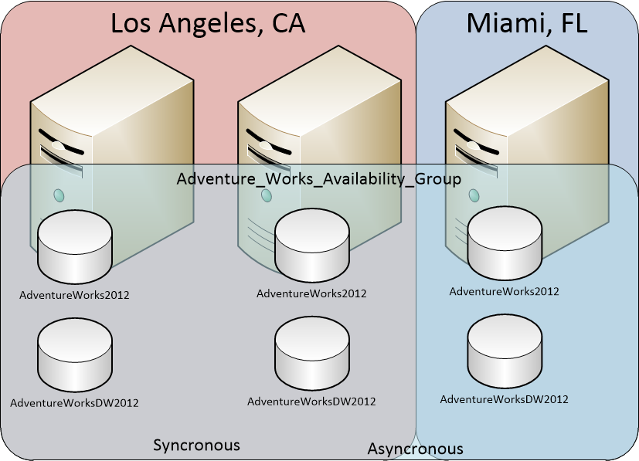
Availability Group Topology

Slide 59
Are AG’s Just Mirroring?
AGs support 4 secondary replicas
2 Synchronous
4 Asynchronous
Transaction Log Stream
Uses encrypted Mirroring endpoint
Secondary Replicas can be read only
Automatic Failover for Synchronous
Notes:
Officially Microsoft supports 100 databases, across 10 Ags. There are no hard limits.

Slide 60
What To Do About Cluster Quorum
Windows 2008 R2
Single Site
Multi Site
Shared Quorum
Majority Node Set
Odd number of nodes
Majority Node Set
Nodes in DR site disabled from voting
Odd Number of nodes in primary site
Notes:
When working in a {click} single site we basically have two options that we want to consider. We can {click} use a shared quorum drive which is a shared volume presented from a shared storage array (aka a SAN) like we always have been able to do in the past. This will support any number of nodes within the cluster however it only allows for a single node or the cluster volume to be down before quorum is lost.
A better option would be to use a {click} majority node set, which would allow for multiple nodes of the cluster to be offline. As long as ½ of the nodes or more are online the cluster will remain online. If using a two node cluster to host an Availability Group a virtual machine could be added to the cluster as a node which doesn’t have SQL Server installed which would be a voting member of the cluster allowing the cluster to maintain quorum. A majority node set requires an odd number of nodes to make this work best.
When working in {click} a multi-site configuration the shared quorum option isn’t going to be available to you as the cluster wouldn’t be able to survive failover as the nodes on the second site wouldn’t be able to access the quorum drive. Your only real option is a {click} majority node set. When setting up a majority node set in a multi-site configuration some special steps need to be taken. The first thing to be done is to disable the nodes in the remote site from being able to vote for quorum. This does something which is both good and bad at the same time; it prevents the second site from coming online automatically. This is good because it prevents a split brain situation in the event of a simple network failure between sites, which is especially important if the Availability Group is configured for synchronous failover between sites. The downside to this is that in the event of an actual total site failure of the primary site it will require human interaction to force the cluster back online at the secondary site.
Configuring the nodes in the secondary site so that they can not vote to be the cluster quorum cannot be done within the Failover Cluster Administrator in Windows Server 2008 R2. It needs to be done via the cluster.exe command line utility.

Slide 61
What To Do About Cluster Quorum
Windows 2012
Single Site
Multi Site
Shared Quorum
Majority Node Set
Odd number of nodes
Majority Node Set
Nodes in DR site disabled from voting
Odd Number of nodes in primary site
Asymmetric Disk Only Quorum
Notes:
When working in a {click} single site we basically have two options that we want to consider. We can {click} use a shared quorum drive which is a shared volume presented from a shared storage array (aka a SAN) like we always have been able to do in the past. This will support any number of nodes within the cluster however it only allows for a single node or the cluster volume to be down before quorum is lost.
A better option would be to use a {click} majority node set, which would allow for multiple nodes of the cluster to be offline. As long as ½ of the nodes or more are online the cluster will remain online. If using a two node cluster to host an Availability Group a virtual machine could be added to the cluster as a node which doesn’t have SQL Server installed which would be a voting member of the cluster allowing the cluster to maintain quorum.
When working in {click} a multi-site configuration the shared quorum option isn’t going to be available to you as the cluster wouldn’t be able to survive failover as the nodes on the second site wouldn’t be able to access the quorum drive. Your first option is a {click} majority node set. When setting up a majority node set in a multi-site configuration some special steps need to be taken. The first thing to be done is to disable the nodes in the remote site from being able to vote for quorum. This does something which is both good and bad at the same time; it prevents the second site from coming online automatically. This is good because it prevents a split brain situation in the event of a simple network failure between sites, which is especially important if the Availability Group is configured for synchronous failover between sites. The downside to this is that in the event of an actual total site failure of the primary site it will require human interaction to force the cluster back online at the secondary site.
Configuring the nodes in the secondary site so that they can not vote to be the cluster quorum can be done within the Failover Cluster Administrator in Windows Server 2012.
Windows Server 2012 introduces a better failover cluster option which is the {click} asymmetric disk only quorum configuration. This is an extremely advanced configuration option which isn’t available in the UI. It requires configuration be done via through the cluster.exe command line tool and it requires a very good understanding of Windows clustering in order to configure correctly. Look for Allan Hurt’s SQL Server 2012 clustering book that’ll be out in Q4 2012 or Q1 2013 for more information on setting this configuration option up.

Slide 62





FCI + AGs
Availability Groups can be built on top of FCIs
Allows for additional redundancy at each site
A
A
A
Notes:
FCI = Failover Clustered Instance
We can build AlwaysOn Availably Groups on top of more traditional Failover Clustered Instances. {click} This provides an additional layer of availability. When using AlwaysOn Availability Groups by themselves there are a maximum of 5 nodes which can host the SQL Server database, three of which can be synchronous copies with each other and two others can be asynchronous copies of the databases. If a server in the cluster was to fail, only four copies of the database will be left.
However if the replicas are hosted on failover clustered instances then when we have the same 5 replicas, hosted within a clustered configuration the failure of an physical machine doesn’t require having a replica offline.

Slide 63
Setup Process
Cluster Windows
Install SQL on needed nodes
Enable AlwaysOn Availability Groups
Create/Attach/Restore database(s)
Configure AlwaysOn Availability Group

Slide 64
Demo!
Notes:
Setup a SQL Server Availability Group in the demo system. Depending on time available have someone from the audience that’s never worked with AGs setup the Availability Group.

Slide 65
Cross Support With Other Features
FILESTREAM
FileTable
ColumnStore Indexes
Full Text Indexes
Replication
Publication
Subscription
Contained Databases
Clustering
Policy Based Management
Maintenance Plans
Auditing
User Defined Server Roles
Transparent Data Encryption
SQL Service Broker
Notes:
One of the big problems with database mirroring was that it didn’t support things like File Stream, FileTable, etc. That isn’t the case with AlwaysOn Availability Groups. The AlwaysOn Availability Groups fully support all of the other features of the SQL Server product including…

Slide 66
Questions?
?

Slide 67
When Should I use Each One?
?
Notes:
Not each of these high availability solutions that we’ve covered is a good fit for every situation. Sometimes we need to use database mirroring, sometimes we need to use AlwaysOn Availability Groups. It really all depends on the situation. In the next section this session becomes more like an interactive workshop. I’m going to put some business cases up on the screen one by one, and we will go through these figuring out what the best high availability solution for each one is.

Slide 68
Business Case #1
Single Data Center
No Single Points of Failure
Least Cost
Multiple Redundant Copies
30 minute or less failover time
Notes:
{Review the requirements with the group}
Break yourselves into small groups, and talk through what your HA options are. Then we’ll have a couple of groups pitch their solutions and see who agrees and who disagrees. We’ll take between 5 and 10 minutes per situation to work out the solution.
{Solution we are going for here would be AlwaysOn, or Log Shipping}

Slide 69
Business Case #2
All Data is stored on the SAN
Three Data Centers
Two Copies of the data in the primary data center
Two Copies of the data in the secondary data center
One copy of the data in the tertiary data center
Short Failover Time
Automatic Failover To Secondary Data Center
SAN Replication is available
Notes:
The primary and secondary data centers are within 30 miles of each other. The third data center is 1000 miles away.
{AlwaysOn is the solution here. We can use synchronous replication to the second server within the primary data center and to one server in the second data center. Then asynchronous replication to the second server in the second data center and to the server in the third data center.}

Slide 70
Business Case #3
All data is stored on DAS
Six Offices, 50 miles between each
Automatic Failover Between 2 offices
No Single Points of Failure
Notes:
{Looking for Database Mirroring between two offices and Log Shipping to the other 4 offices. This allows for automatic failover between two offices, and manual failover between the other 4 offices.}

Slide 71
Business Case #4
All data is stored on the SAN
3 Redundant Servers
Lowest Hardware Costs
Notes:
{SQL and Windows Clustering provides the lowest hardware costs while protecting against hardware failure. While this doesn’t protect against disk failures, it does meet the business requirements requirements.}

Slide 72
Business Case #5
Three Data Centers
20 miles between primary and secondary
400 miles between primary and 3rd
Automatic Failover between primary and secondary
Multiple Servers Per Data Center
All Data on SAN Storage
Lowest Storage Costs
Notes:
{AlwaysOn Availability Groups for remote HA using SQL Server Clustering for local HA.}

Slide 73
Additional Reading
http://mrdenny.com/res/hadr

Slide 74
SQL Server 2012 in a Highly Available World
Denny Cherry
mrdenny@mrdenny.com
twitter.com/mrdenny

